Slide 1
ELSA – Our Journey

Slide 2
Why where we chosen to become ELSA’s?
Warm personality
Demonstrate good interpersonal skills with children and adults
Enjoys learning
To work independently and show initiative
Good time management and organisation skills
Able to plan programmes of support that incorporate variety, interest and pace.
To keep succinct records of involvement.
Gain the child's confidence and build the relationship.
Between us we have 18 years experience of working with children with challenging behaviours, SEMH, social communication difficulties and we have a wealth of experience of building relationships with both children, parents and staff.

Slide 3
Hopes
Fears
Am I going to be a good ELSA
Am I the right person who can relate and gain the confidence of our more challenging/vulnerable children.
That your intervention is not producing the magical outcomes that you are expecting, you have to keep reminding yourself it’s all about the little wins.
To continue the ELSA journey – am I going to get the full support of my school to deliver the required interventions.
Our timetables and daily school life that impact on our ability to deliver meaningful, consistent interventions.
We were lucky enough to be able to go together
Knowing we were being trained by Educational Psychologists
Knowing we would have the support of the other ELSA’s within the borough along with the wider ELSA network.
That we would have a fantastic program of work, which was tried and tested and proven to make a difference.
To further own professional development, personal knowledge and understanding on emotional literacy
Helping children understand it’s ok to not be ok, and we are there to help unpick the reasons behind their feelings and emotions, in a way that allows them to feel comfortable to open up and have trust that someone genuinely wants to help.

Slide 4
Training
Go with an open mind and a determination to learn, so you get the best from this programme.
Be prepared, be ready as sometimes it can be emotional on a personal and professional level.
The delivery of the course is key, and this we’ve got to say was outstanding. It was fun, thought provoking, inclusive and supportive.
Sharing of your own knowledge, sharing best practice and getting reassurance that you are doing a good job.
ELSA role starts from the very first session, so you gain that key confidence on being called an ELSA.
The training met every learning style, kinaesthetic, visual and auditory. Practical, hands on, TED talks, and all linked to Psychology Theories and practices.
Realising that the challenges we face each day are not exclusive to your class, year group, school or borough. We are all facing the same challenges.

Slide 5
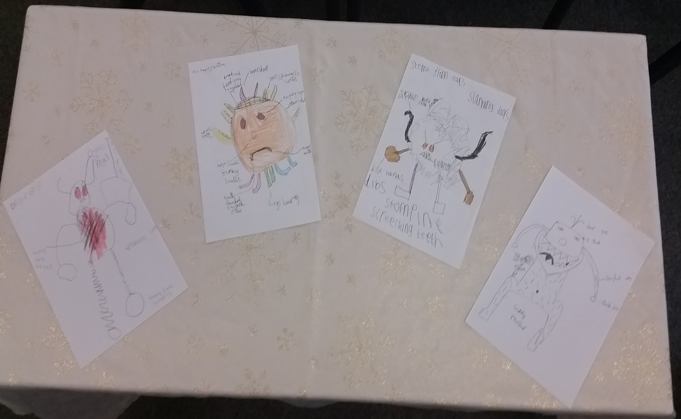
Practice and Resources

Slide 6
Supervision
It’s amazing!
It’s not an observation, it’s a support network, sharing ideas, helping each other to gain the confidence of the child/children you are working with.
Makes you reflect on your own practice, although uncomfortable at first becomes very beneficial for your professional development.
It gives us a safe space to discuss the highs and lows (not many) of being an ELSA.
It’s having the other ELSA’s and ED psych validating that you are actually doing a good job and making a difference to that young persons life.
We have a What’sApp group to share resources
Access to the ELSA monthly news letter and website which offers ELSA resources, including full schemes of work, planning and Pre/Post intervention assessments to measure impacts.

Slide 7
They may not remember what they did in your intervention, but they will remember how it made them feel.
Thank you for listening Lesley and Vicki

