Slide 1
Carl.geraghty@vibeuk.org
Project Lead

Slide 2
Outreach
You may have seen our youth workers out and about on a Thursday, Friday and Saturday across Widnes and Runcorn.
We offer:
Sexual health advice and contraception
Signpost YP to other agencies
Notes:
Real time intervention to prevent ASB, criminal activity

Slide 3
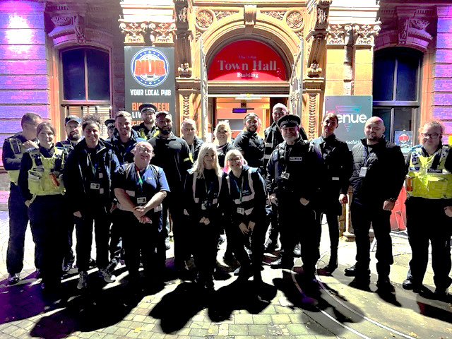
Halton – Partnership work
Mischief night – Multi agency hub
Lock out events @ The venue
Silver jubilee – Fireworks
Notes:
Good feedback from chief inspector Andy blizzard

Slide 4
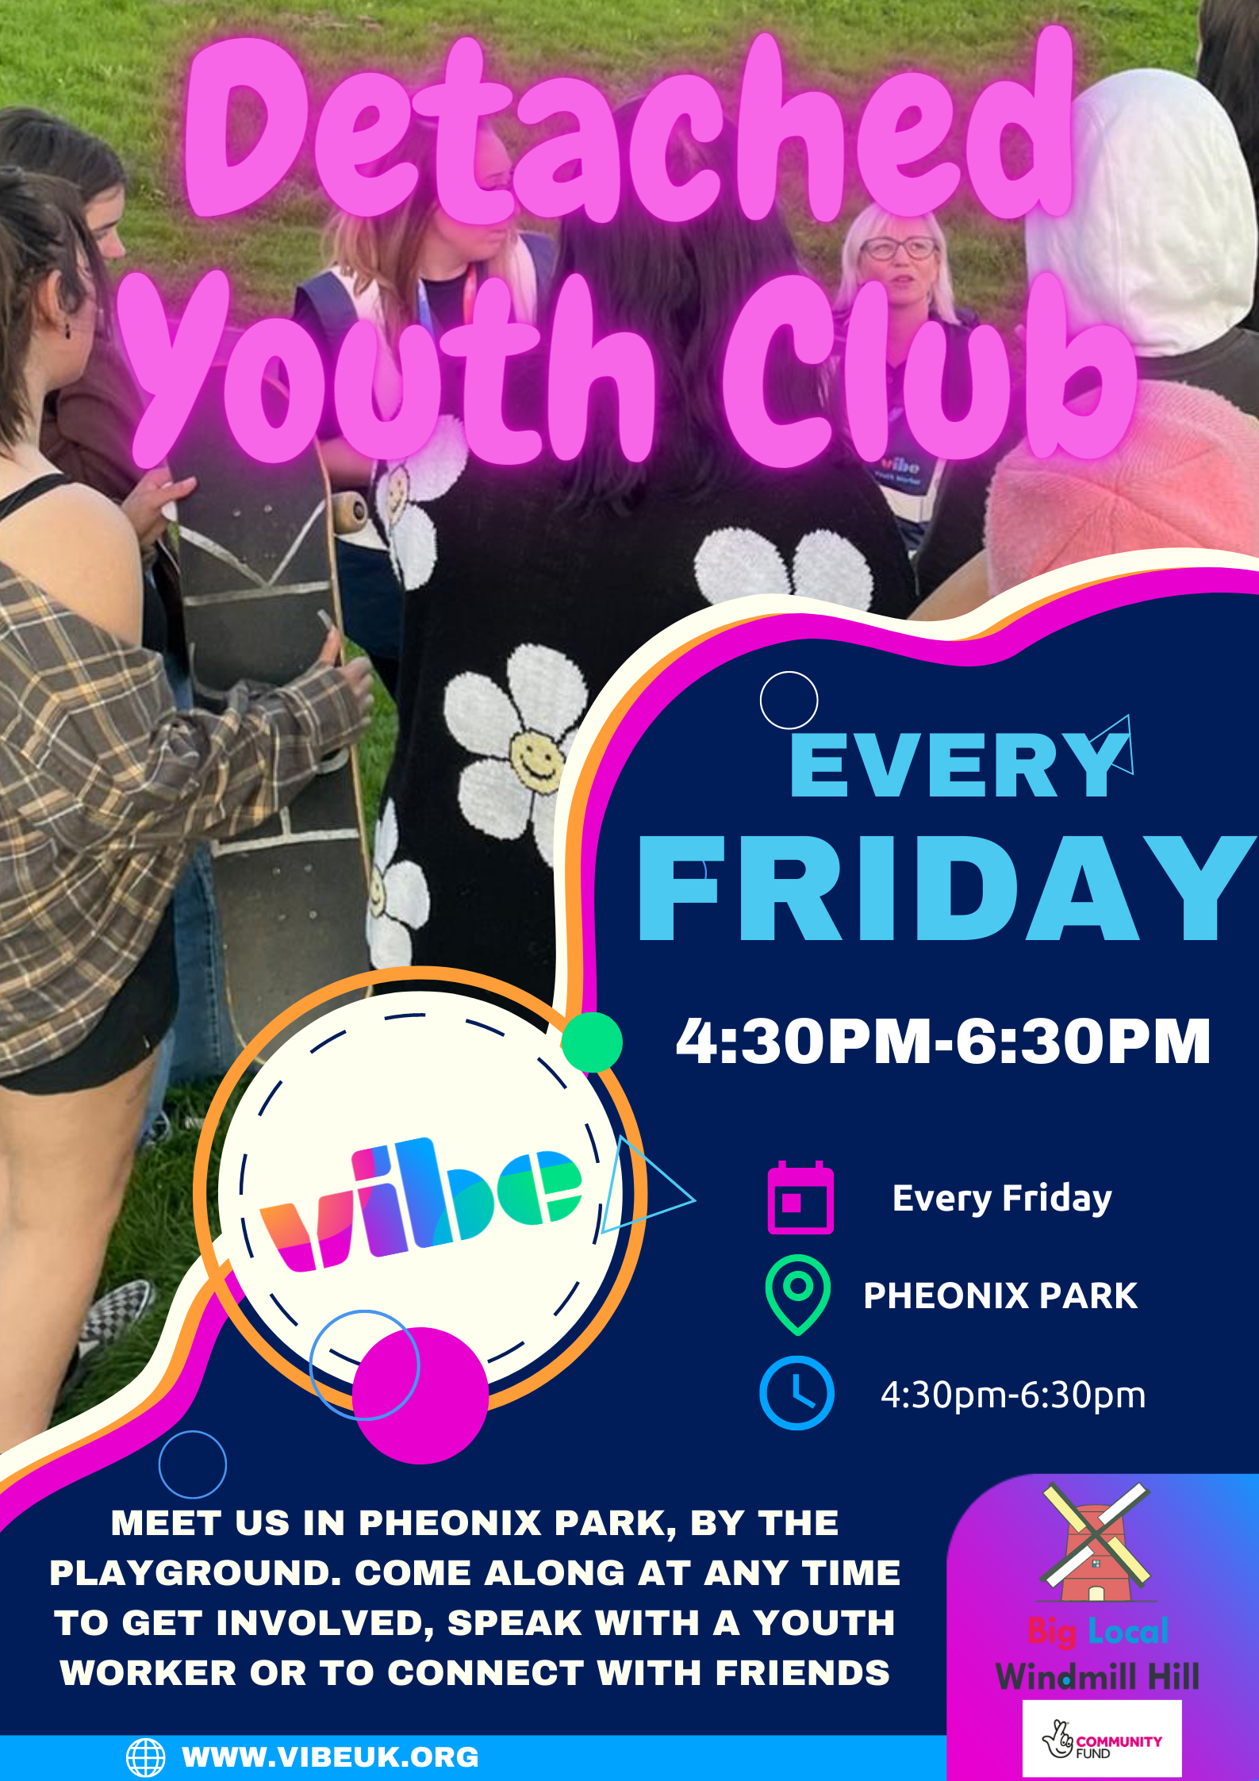
Halton Detached Youth Work Riverside Housing
Halton Detached Youth Work Windmill Hill
Notes:
Two detached sessions in Runcorn
We meet the same group each week over in palace fields and on phoenix park

Slide 5
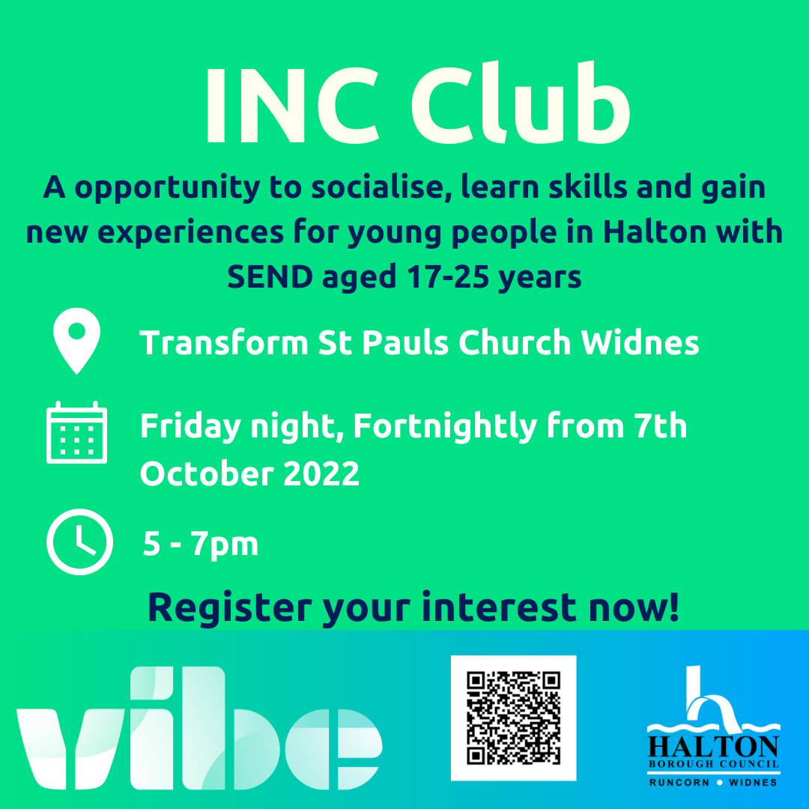
Halton INC:
Notes:
Inclusive needs club
Every fortnight build social development

Slide 6
Halton Interact
Cohort 12 YP
12-week program
Notes:
Hidden Harm
Parental substance misuse or co occurring mental health
Respite for YP

Slide 7
Halton area contracts:
What is coming in Winter 2022/23?
Notes:
Out cold – substance misuse course in partnership with Cheshire police
1 x 4 hours session a month in each area for first offence YP
Mandatory before they enter the YJS
PVP – 12 week
Both police referrals

Slide 8
Halton area pipeline:
Where's Your Head At?
Where's Your Head At is a twelve-week project focusing on improving your mental health and wellbeing through engaging activities in a safe space.
Worries
Vibe Outdoors
Self Care
Goal Setting
Coping strategies
Nature
Relationships
Mindfulness
Relaxation
Notes:
12 week mental programme
2 cohorts pending for Runcorn schools awaiting funding
Previous funding from health improvement
The grange
Wade deacon

